Slide 1
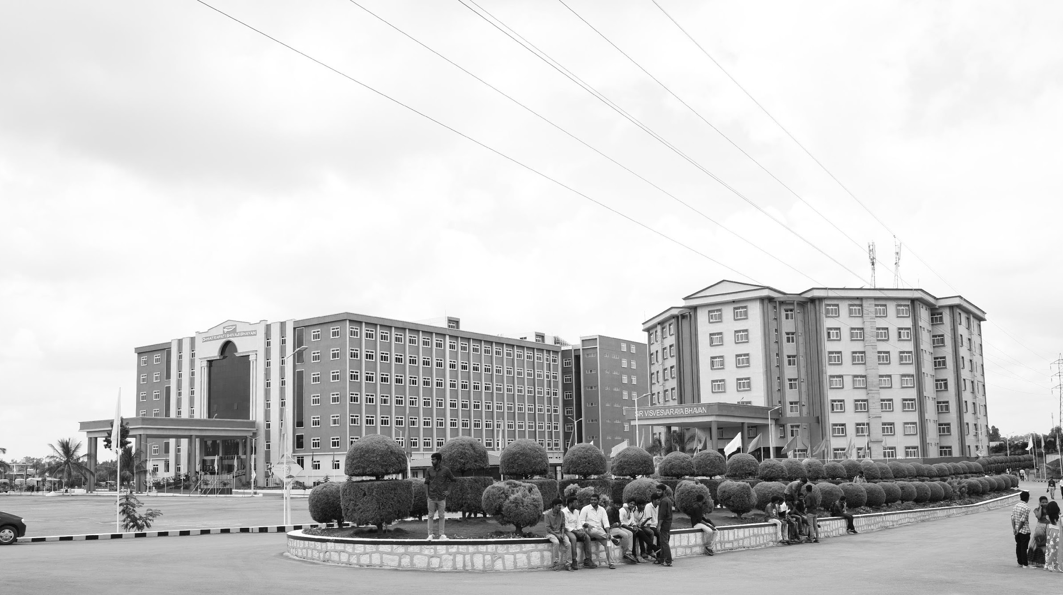

A Dielectrically Modulated GaN/AlN/HfAlOx MOSHEMT with a Nanogap Embedded Cavity for Biosensing Applications
AY 2021-25
GITAM UNIVERSITY
Major Project
Project ID: V12
A University should be a place of light, of liberty, and of learning.
Department of Electrical Electronics and Communication Engineering
Project Team:
Piyush Kumar
Athukuri V S Sai Jayanth
R Hima Bindu
Project Mentor:
Mr. Girish Shankar Mishra
www.gitamedu.com

Slide 2

Project Group – Details
Photo
Track
Roll No
Name
Photo
EECE AI/ML
BU21EECE0100207
PIYUSH KUMAR
Photo
EECE AI/ML
BU21EECE0100310
ATHUKURI V S SAI JAYANTH
Photo
EECE AI/ML
BU21EECE0100087
R HIMA BINDU

Slide 3
Objective and Goals
Objective
Brief Description: The GaN/AlGaN material system displays excellent sensitivity, compatibility with living organisms, stability in various chemical environments, and rapid response times. Biosensor employs modulation of two-dimensional electron gas (2DEG) at heterojunction to accurately detect surface charge. The key innovation is that Al₂O₃ passivation enhances surface uniformity, reduces defect density, and enhances device stability.
Goals
Main Goals
Early Detection of Pathogens
High Sensitivity and Accuracy
Surface Charge Detection
Additional Goals
Miniaturization and Quick Response
Improved Chemical Stability
Multi-functional Biosensor Development

Slide 4
Project Plan
Gant Chart - Milestones and Activities

Slide 5
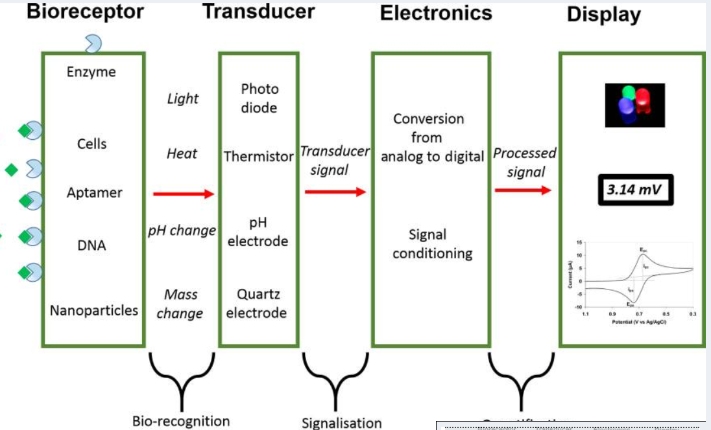
What are Bio-Sensors?
A biosensor is a device that measures biological or chemical reactions by generating signals proportional to the concentration of an analyte in the reaction. Biosensors are employed in applications such as disease monitoring, drug discovery, and detection of pollutants, disease-causing micro-organisms, and markers that are indicators of disease in bodily fluids (blood, urine, saliva, sweat).
The Analyte is the substance of interest to be detected;
Bioreceptors specifically recognize the analyte and initiate bio-recognition;
The transducer converts this event into a measurable signal;
Electronics process and condition this signal;
The Display presents the results in a user-friendly format.

Slide 6
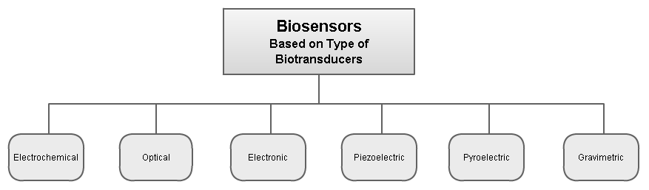

Slide 7
WHAT IS HEMT(HIGH ELECTRON MOBILITY TRANSISTOR)?
Properties
HEMT biosensors are based on a two-dimensional electron gas (2DEG) that can amplify current changes. They can be used for label-free, real-time, and direct detection.
Structure
HEMTs are heterostructure field-effect transistors (FETs) that are made from at least two different semiconducting materials.
Applications
HEMT biosensors can be used to detect C-reactive proteins and other biomolecules.
Advantages
HEMT biosensors have large surface sensitivity and heterostructure accessibility.

Slide 8
Literature Survey
Sl.no | Title | Methodlogy | Merits | Research | Year of Published
1 | A Dielectrically Modulated GaN/AlN/AlGaN MOSHEMT with a Nanogap Embedded Cavity for Biosensing Applications | The research explores the design and simulation of a GaN/AlN/AlGaN MOS-HEMT (Metal-Oxide-Semiconductor High Electron Mobility Transistor) with an embedded nanogap cavity beneath the gate on the drain side. The device's sensitivity as a biosensor is analyzed through dielectric modulation of the cavity region, simulating the presence of various neutral and charged biomolecules. | High Sensitivity Enhanced Device Performance Versatile Detection Capability Scalability and Stability | The research identifies a gap in the development of biosensors capable of detecting both neutral and charged biomolecules with high sensitivity. While previous studies have focused on silicon-based FET sensors and dielectric-modulated devices. | IEEE Sensors Journal on August 14 2022

Slide 9
Literature Survey
Sl.no | Title | Methodlogy | Merits | Research | Year of Published
2 | Open gate AlGaN/GaN HEMT biosensor: Sensitivity analysis and optimization | The study proposes a physics-based analytical model for an open gate AlGaN/GaN HEMT (High Electron Mobility Transistor) designed for the electrical detection of biomolecules such as uricase, glucose, biotin, and cytochrome-c. The model evaluates the sensitivity of the device by analyzing the drain current and threshold voltage under the influence of different biomolecules. The analytical model considers the immersion of the gate electrode in a de-ionized water solution and is validated using simulation results obtained from the ATLAS TCAD device simulator. | High Sensitivity Easy Fabrication Model Validation Optimization Potential | The research addresses the need for highly sensitive, low-cost biosensors capable of detecting various biomolecules. Previous works have focused on silicon-based FETs and their limitations in terms of sensitivity and stability. | IEEE Sensors Journal on June 10, 2020

Slide 10
Literature Survey
Sl.no | Title | Methodlogy | Merits | Research | Year of Published
3 | Recessed Mg-doped P-type In0.2Ga0.8N cap Gate AlGaN/GaN/AlGaN DH-HEMT for High breakdown and Power Electronics Applications | The research is focuses on developing a recessed Mg-doped P-type InGaN cap gate AlGaN/GaN/AlGaN double heterostructure HEMT (DH-HEMT) for high-power and breakdown voltage applications. By incorporating a P+ InGaN cap layer, the device achieves normally-off operation with a high threshold voltage and reduced leakage current. The study uses 2D Sentaurus TCAD simulations based on a hydrodynamic model to analyze device performance, focusing on non-equilibrium transport effects. The results show significant improvements in drain current, breakdown voltage, and leakage current reduction, making the device highly suitable for power electronics applications​. | Normally-off Operation Enhanced Carrier Confinement Increased Drain Current Low Leakage Current | The research develops a recessed Mg-doped P-type InGaN cap gate AlGaN/GaN/AlGaN DH-HEMT for high-power electronics. It achieves normally-off operation with a high threshold voltage, improved breakdown voltage, and reduced leakage currents. The P+ InGaN cap enhances carrier confinement and device performance for high-frequency applications. This makes the device ideal for high-voltage switching and power electronics​ | IEEE Sensors Journal on 2021​

Slide 11
Literature Survey
Sl.no | Title | Methodlogy | Merits | Research | Year of Published
4 | Analysis of Partial Hybridization and Probe Positioning on Sensitivity of a Dielectric Modulated Junctionless Label Free Biosensor | The study models a Dielectric Modulated Junctionless MOSFET-based biosensor using Silvaco ATLAS to optimize nanocavity design and improve sensitivity. It analyzes threshold voltage shifts and drain current changes, accounting for partial hybridization of bioanalytes with varying dielectric constants. Sensitivity is assessed through probe positioning and nanocavity configurations to determine the optimal design for enhanced detection.​. | High Sensitivity Effective Partial Hybridization Analysis Accurate Simulation Versatile Biomolecule Detection | This research focuses on optimizing a Dielectric Modulated Junctionless MOSFET-based biosensor for enhanced biomolecule detection. It examines how nanocavity design, partial hybridization, and probe positioning affect sensitivity and performance, using Silvaco ATLAS simulations and analytical models. The study identifies optimal configurations for improved detection of proteins and DNA, offering insights for practical biosensing applications | IEEE Sensors Journal on September 2020.

Slide 12
Analysis - SWOT
Strengths
Weaknesses
W1. Cavity Fill Incompleteness
W2. Dependence on Biomolecule Charge
W3. Complexity in Fabrication
W4. Geometrical Constraints
S1. High Sensitivity
S2. Dual Biomolecule Detection
S3. Enhanced 2DEG Properties
S4. Optimization Flexibility
Opportunities
Threats
O1.Medical Diagnostics and Early Disease Detection
02. Environmental Monitoring
O3. Point-of-Care Testing
04. Integration with Wearable and Implantable Devices
T1. Fabrication and Scalability Challenges
T2. Interference and Environmental Sensitivity

Slide 13
Analysis – 4W1H
Why:
We are conducting this project to enhance the performance of GaN-based transistors in terms of switching speed, power efficiency, and sensitivity for applications like high-power electronic devices and biosensors. Replacing Al₂O₃ with HfAlOX is done because HfAlOX provides better dielectric properties and can improve the stability and efficiency of the device.
What:
The project simulates and optimizes a GaN-based transistor architecture using a high-performance dielectric layer, HfAlOX, to reduce gate leakage and enhance overall device performance. The primary aim is to explore improvements in the gate dielectric and channel materials to increase the sensitivity for detecting specific biological markers (SARS virus).
Where:
This simulation uses TCAD (Technology Computer-Aided Design) software, which allows precise modeling and simulation of semiconductor devices. The simulation replicates the real-world physics of GaN-based transistors with detailed layer analysis.
When:
The simulations are conducted at different stages of transistor development to evaluate performance under varying conditions. Specific focus is given to early design stages where materials like HfAlOX can significantly impact device characteristics.
How:
By employing TCAD, the project simulates the impact of replacing Al₂O₃ with HfAlOX. The tool provides insights into the electrical characteristics, such as threshold voltage, gate capacitance, and leakage current. The architecture is optimized by modifying parameters like gate length, source-drain distance, and material thicknesses.
Refined Objective:
Improve GaN transistor performance by utilizing HfAlOx as the gate dielectric material, aiming for better sensitivity and reduced power consumption in applications like biosensors and high-power electronics.

Slide 14
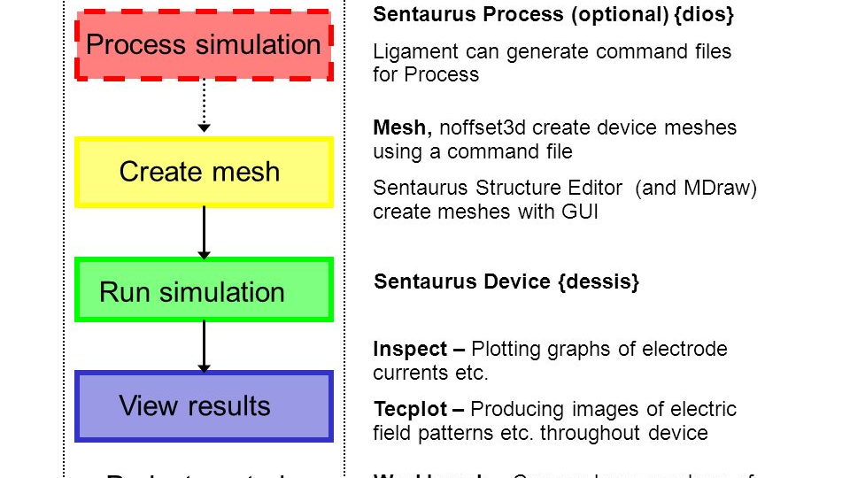

Slide 15
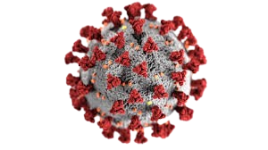
Architecture
L_{DS} = 3μm
L_{SG} = 2μm
L_{G} = 3μm
Structural Diagram
L_{cavity} =1.5 μm
L_{oxide}=1.5 μm
Gold – Gate(0.05µm)
L_{D} = 1μm
L_{S} = 1μm
SiO2
(0.013µm)
HfAlOx (0.002µm)
Source
0.029(µm)
AlGaN -- barrier(0.025µm)
Drain 0.029(µm)
AlN -- Spacer(0.002µm)
GaN -- Channel(2µm)
AlN – Nucleation(0.03µm)
SiC -- Substrate(2µm)
10µm

Slide 16
1. Substrate (SiC - 2μm)
Material: Silicon Carbide (SiC)
Thickness: 2 micrometers (μm)
Purpose: The substrate is the base layer that provides structural support and influences thermal conductivity. SiC was chosen for its high thermal conductivity, which makes it suitable for high-power and high-frequency applications.
2. Nucleation Layer (AlN - 0.03μm)
Material: Aluminum Nitride (AlN)
Thickness: 0.03 micrometers
Purpose: This thin nucleation layer facilitates the growth of subsequent layers by providing a buffer that improves the quality of crystal formation. AlN helps reduce defects and enhances the epitaxial growth of the following layers.
3. Channel Layer (GaN - 2μm)
Material: Gallium Nitride (GaN)
Thickness: 2 micrometers
Purpose: The GaN layer forms the channel where electron flow occurs. GaN is well-known for its high electron mobility, making it ideal for fast-switching devices. This layer plays a critical role in high-speed performance and low power loss.
4. Spacer Layer (AlN - 0.002μm)
Material: Aluminum Nitride (AlN)
Thickness: 0.002 micrometers (or 2 nanometers)
Purpose: This thin spacer layer separates the GaN channel and the AlGaN barrier. It improves electron confinement in the channel, reducing scattering and increasing mobility.
5. Barrier Layer (AlGaN - 0.025μm)
Material: Aluminum Gallium Nitride (AlGaN)
Thickness: 0.025 micrometers
Purpose: The AlGaN layer acts as a barrier to control the movement of electrons and improve the confinement of the two-dimensional electron gas (2DEG) in the GaN channel. This layer significantly contributes to the transistor's sensitivity and electron mobility.

Slide 17
6. Gate Dielectric Layer (HfAlOx - 0.002μm)
Material: Hafnium Aluminum Oxide (HfAlOx)
Thickness: 0.002 micro-meters
Purpose: This layer is the dielectric between the gate and the semiconductor. HfAlOx has a high dielectric constant, which allows for effective gate control over the channel with reduced leakage current, enhancing device performance and sensitivity.
7. Gate Structure
Gold Gate (0.05μm):
Material: Gold (Au)
Thickness: 0.05 micro-meters
Purpose: The gold gate controls the electric field in the MOSHEMT. Gold is often used due to its excellent conductivity.
SiO2 Layer (0.013μm):
Material: Silicon Dioxide (SiO2)
Thickness: 0.013 micro-meters
Purpose: The SiO2 layer provides insulation for the gate. It helps prevent direct contact between the gold gate and other semiconductor parts, ensuring better electric control.
Gate Dimensions:
The gate length (LG) is 3μm, affecting the device’s overall performance, especially in speed and efficiency.
8. Source and Drain Regions
Material: Likely highly doped semiconductor (specific material not mentioned).
Dimensions:
Source Length (LS) and Drain Length (LD) are both 1μm.
Source-to-Gate Length (LSG) is 2μm.
Drain-to-Source Length (LDS) is 3μm.
Purpose: These regions provide the points where current enters (source) and exits (drain) the device. Their dimensions and positioning affect the device’s current flow, electron mobility, and efficiency.

Slide 18
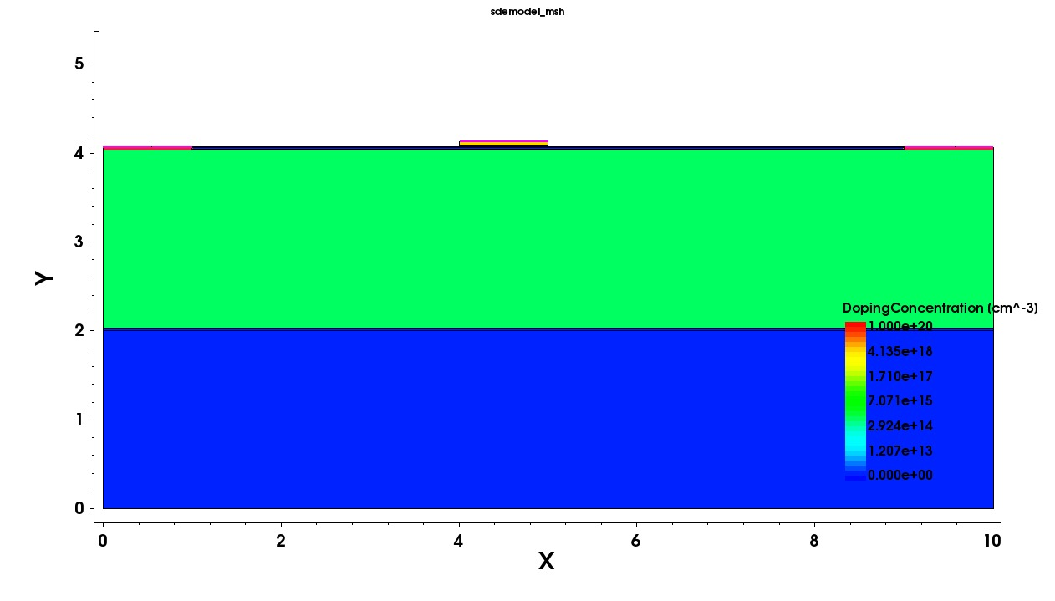
Architecture
Behaviour Diagram

Slide 19
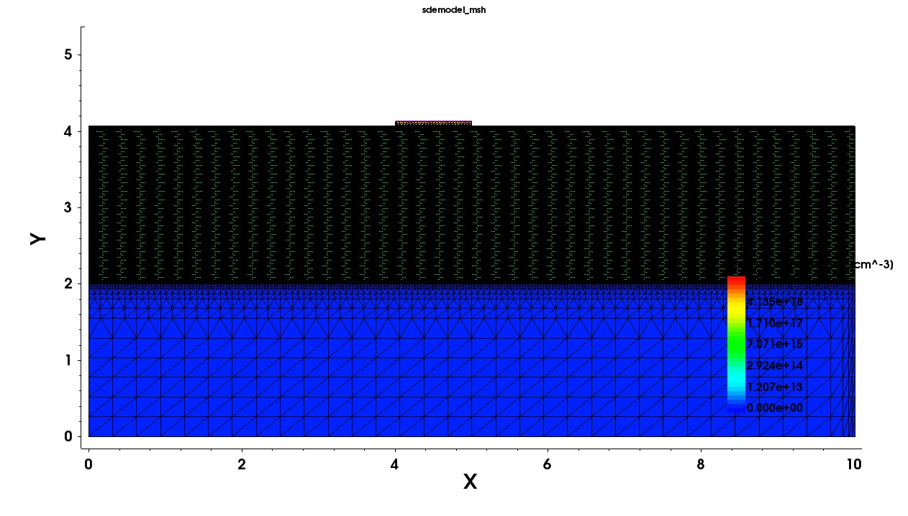
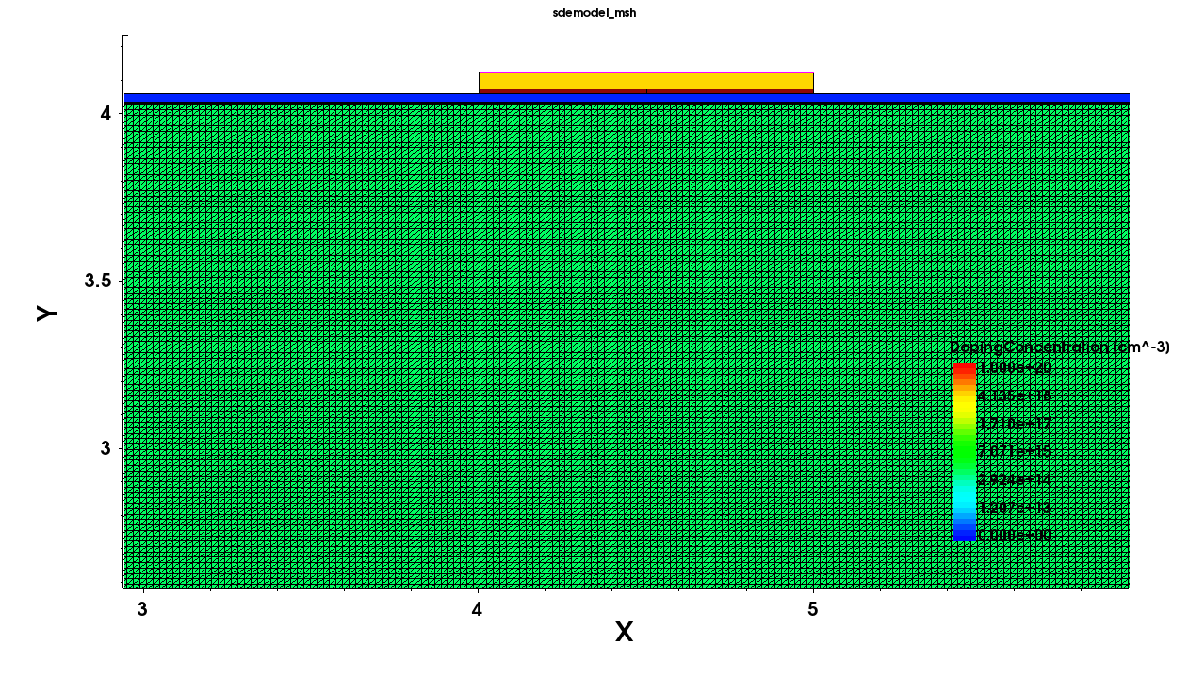
Architecture
Behaviour Diagram

Slide 20




hhhhhm
C_{ox}:Capacitance between the gate and the channel.
𝜀_{ox}: Permittivity of the gate oxide material.
_{tox}: Thickness of the oxide layer.
C_{bio}: Capacitance.
𝜀_{bio}:Permittivity of the biological material.
t_{bio}:Thickness of the biological layer.
C_{cavity}:The total capacitance of a system.
C_{bio}: Capacitance of the biological layer.
CAl₂O₃:Capacitance of the aluminum oxide layer.
C _{effect}: Total effective capacitance.
CSiO₂:Capacitance of a silicon dioxide layer.
C _{cavity}:Capacitance of a cavity, which could include other materials like C_{bio}​ and CAl₂O₃.

Slide 21





C _{total}:The combined or equivalent capacitance of the system.
C _{effect}: Capacitance due to one part of the structure.
C _{AlGaN}: Capacitance of a layer of aluminum gallium nitride
C _{AlGaN}:Capacitance of the AlGaN layer.
𝜀 _{AlGaN}: Permittivity of the AlGaN material, indicating its ability to store electric charge.
T _{AlGaN}: Thickness of the AlGaN layer.
𝜀_{AlGaN}:Permittivity of the AlGaN material.
m:This variable could represent a physical parameter.
Saturation region:
Linear region:

Slide 22
Use Cases & Testing
Use Cases
Disease Diagnostics:
Use: Biomarkers of diseases such as cancer, heart disease or infectious disease, such as COVID-19, in the body fluids: An example through which PSA can be detected for screening prostate cancer or DNA mutations in genetic disorders is through blood or saliva
Environmental Monitoring:
Use: Monitoring water quality by detecting the presence of pathogens like E. coli or toxins produced by harmful algal blooms. It can also be used for air quality control by detecting airborne viruses or pollutants.
Point-of-Care Testing (POCT):
Use: Using the biosensor in a handheld device for quick testing of blood glucose, cholesterol levels, or specific infections like HIV, without needing a full lab setup.
Food Safety and Quality Control:
Use: Identifying harmful bacteria such as Salmonella or Listeria in meat or dairy products, or detecting pesticide residues in fruits and vegetables.
Test Cases
Biomolecule Detection Sensitivity Test:
Objective: To measure the sensitivity of the biosensor to different biomolecules (both neutral and charged).
Threshold Voltage Shift Test:
Objective: To assess the accuracy of the sensor in detecting changes in threshold voltage caused by biomolecule introduction
Selectivity Test:
Objective: To evaluate the ability of the biosensor to differentiate between various types of biomolecules.
Geometrical Parameter Variation Test:
Objective: To test the impact of varying device parameters (AlGaN layer thickness, cavity height, etc.) on sensor performance.
Temperature Stability Test:
Objective: To ensure the sensor’s stability and performance across varying Temperature.

Slide 23
Implementation and Results – Iteration 1
Iteration 1: Implementation
The structure of the biosensor is based on GaN/AlN/HfAlOx MOS-HEMT, which has a nanogap cavity placed below the gate. Its essential layers are: Substrate: 2 μm thick GaN buffer layer to form the substrate. This uses a 2 nm aluminum nitride (AlN) spacer layer to suppress the scattering and elevate mobility. It is provided with an AlGaN barrier layer of 20–30 nm thickness to form the 2DEG channel responsible for high electron mobility. A thin layer of passivation Al2O3 is applied on top of HfAlOx for stabilization enhancement and stronger adhesion to biomolecules while suppressing leakage current. This nanogap cavity is doped at a length of 0.5 μm and height of 13 nm and falls onto the drain side under the gate for capturing the biomolecules. Source and drain regions extend up to 2 μm and 3 μm, respectively. Geometrical Parameters To evaluate the influence of layer thickness and cavity fill height on sensitivity, the thickness of the AlGaN layer was varied. For the experiments, the used thicknesses of the AlGaN layer were 20, 25, and 30 nm to find out how the layer thickness influences the electrical shifts generated after introducing biomolecules into the cavity. The fill height of the cavity was varied in filled and half-filled conditions to observe the effect of biomolecule presence on the performance of the device.

Slide 24
Implementation and Results – Iteration
Iteration :
(sdegeo:create-rectangle (position 0 0 0) (position 10 2 0) "")
(sdegeo:create-rectangle (position 0 2 0) (position 10 2.03 0) "AlN" "nucleation")
(sdegeo:create-rectangle (position 0 2.03 0) (position 10 4.03 0) "GaN" "buffer")
(sdegeo:create-rectangle (position 0 4.03 0) () "AlN" "spacer")
(sdegeo:create-rectangle (position 0 4.032 0) (position 10 4.057 0) "AlGaN" "supply")
(sdegeo:create-rectangle () (position 10 4.059 0) "Al2O3" "oxide")
(sdegeo:create-rectangle (position 0 4.03 0) (position 1 4.059 0) "Silicon" "source")
(sdegeo:create-rectangle (position 10 4.03 0) (position 9 4.059 0) "Silicon" "drain")
(sdegeo:create-rectangle (position 4.5 4.059 0) (position 5 4.072 0)
(sdegeo:create-rectangle (position 4 4.073 0) (position 5 4.123 0) "Silicon" "gate")
(sdegeo:define-contact-set "source" 4 (color:rgb 1 0 0 ) "##")
(sdegeo:define-contact-set "drain" 4 (color:rgb 1 1 0 ) "##")
(sdegeo:define-contact-set "gate" 4 (color:rgb )
(sdegeo:set-current-contact-set "source")
(sdegeo:set-current-contact-set "drain")
(sdegeo:set-current-contact-set "gate")
(sdegeo:set-current-contact-set "source")
(render:rebuild)
(sdegeo:set-current-contact-set "gate")
(sdegeo:set-contact-edges (list (car (find-edge-id (position 4.5 4.123 0)))) "gate")
(render:rebuild)
(sdegeo:set-current-contact-set "drain")
(sdegeo:set-contact-edges (list (car (find-edge-id (position 9.5 4.059 0)))) "drain")

Slide 25
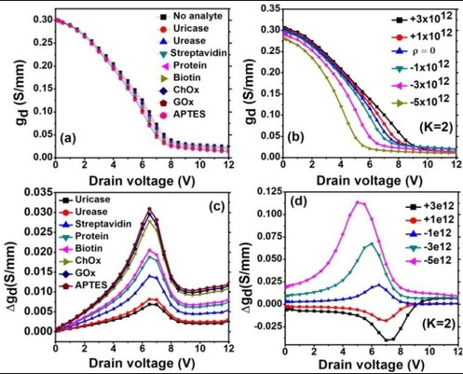
Implementation and Results

Slide 26
Contribution
Team Progress and Movement
Working on the Design & Structure
Individual Contribution
Key contributions: Piyush Kumar
Structure
Articles & Doping
Key contributions: A V S Sai Jayanth
Contacts
Material studies
Key contributions: R Hima Bindu
Documentation
Meshing

Slide 27
Conclusion & Future Work
Summary and Conclusion :
It is discussed the GaN/AlN/AlGaN MOS-HEMT structure with the embedded cavity for biosensors. From the potential changes in dielectric modulation, threshold voltage and drain current shifts are exploited for detecting neutral and charged biomolecules. The electrostatic properties have been found to be modified by the simulations carried out in the tool ATLAS Silvaco. Therefore, it should be a potential biosensor for the DNA and proteins sensed with high sensitivity.
The cavity within the structure of the GaN/AlGaN HEMT, placed below the gate from the drain side, has been proved to be a biosensor. Biosensing both charged and neutral biomolecules becomes possible because of the electrical threshold voltage ΔVth and the change in drain current ΔIDS. When neutral species were sensed, the parameters ΔVth change from 305 mV to 1.12 V, ΔIDS from 35.1 to 153.7 mA/mm. While the DNA biomolecules are charged, ΔVth shifts up to 0.30 V and ΔIDS up to 65.2 mA/mm. The variation in the device parameters increases the sensitivity for biomedical applications.
Future Work:
The proposed device also shows much potential in high-sensitivity applications, such as the detection of neutral and charged biomolecules. The future advancements may include material optimization, proper fabrication techniques of the device, extended applications beyond biosensing, and maybe integration into various wearable or point-of-care devices to meet the ever-growing demand for portable diagnostic tools in healthcare.

Slide 28

THANK YOU

